Slide 1

Transaction Processing Task 1D
Ibtisam Mogul
Notes:
NOTE:
To change the image on this slide, select the picture and delete it. Then click the Pictures icon in the placeholder to insert your own image.

Slide 2
Contents
Transaction
ACID Properties
State Transition Diagram for Transaction Processing

Slide 3
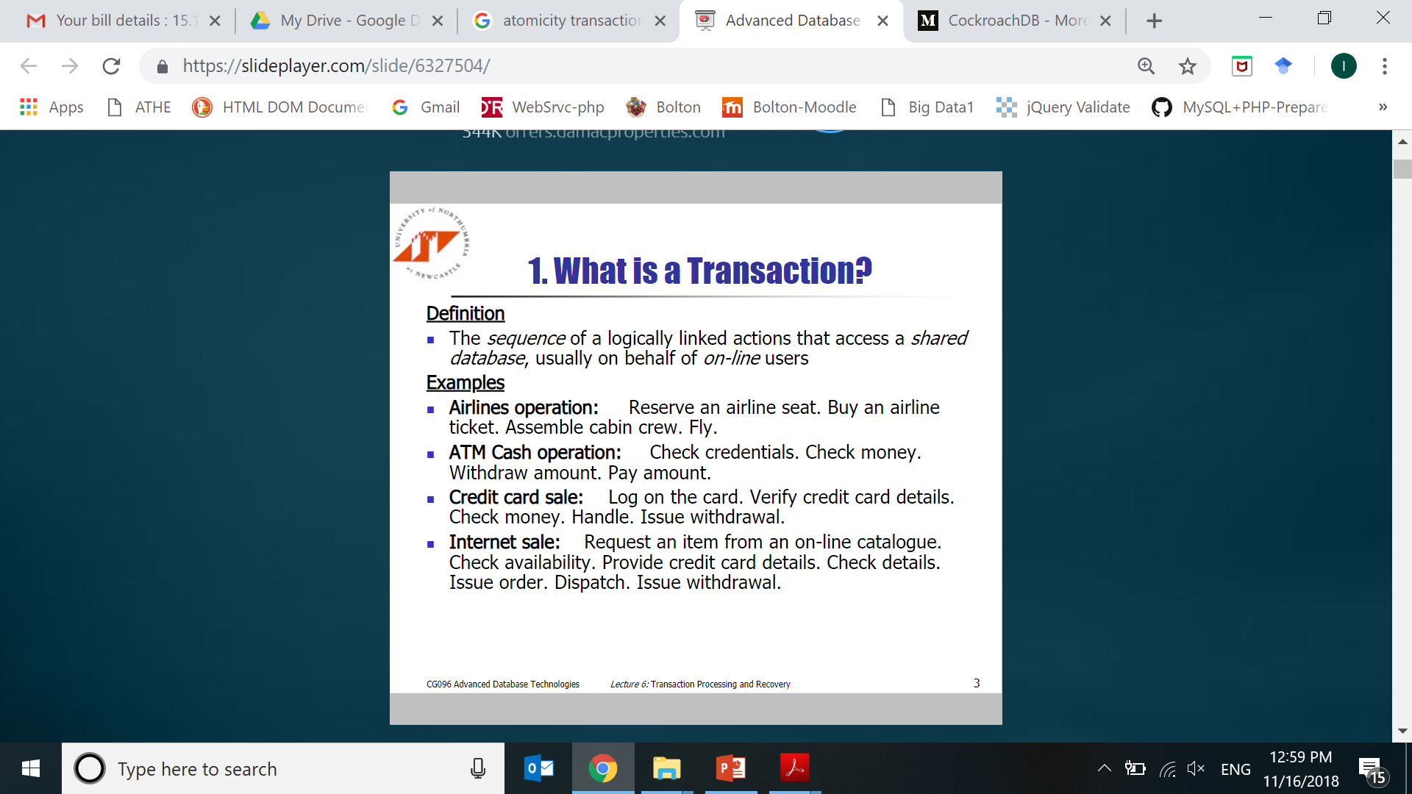
Transaction
A transaction is
an action, or a series of actions,
carried out by a single user or an application program,
which reads or updates the contents of a database.
Logical unit of work on the database.
Notes:
https://slideplayer.com/slide/6327504/

Slide 4
Transaction
Enroll a student
MARY to ATHE4.4
steps:
start
1.check to see if student "MARY" exists… read only
2.check to see if class "ATHE4.4" exists.. read only
3. access enrollment table .. read only
update enrollment table ..make changes (update)
4. access student record/table ..read only
update student table ..make changes (update)
5. access class record/table
update class table
6.commit transaction
end
Notes:
Ch 10: Transaction Management and Concurrent Control
home.ubalt.edu/ntsbagga/web/INSS%20651_F07/lecture9_Transaction_aggarwal.ppt

Slide 5
Transaction Concept
A transaction is a unit of program execution that accesses and possibly updates various data items.
E.g. transaction to transfer AED 50 from account A to account B:
1. read_from_account(A)
2. A = A – 50
3. write_to_account(A)
4. read_from_accont(B)
5. B = B + 50
6. write_to_account(B)
Two main issues to deal with:
Failures of various kinds, such as hardware failures and system crashes
Concurrent execution of multiple transactions

Slide 6
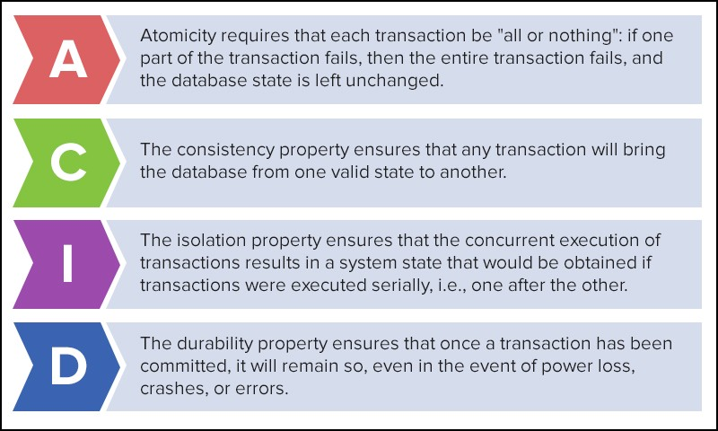
Solution
Notes:
https://medium.com/@openxcell/cockroachdb-more-than-just-an-invincible-database-4d05ad534379

Slide 7
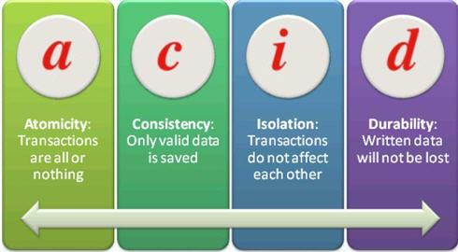
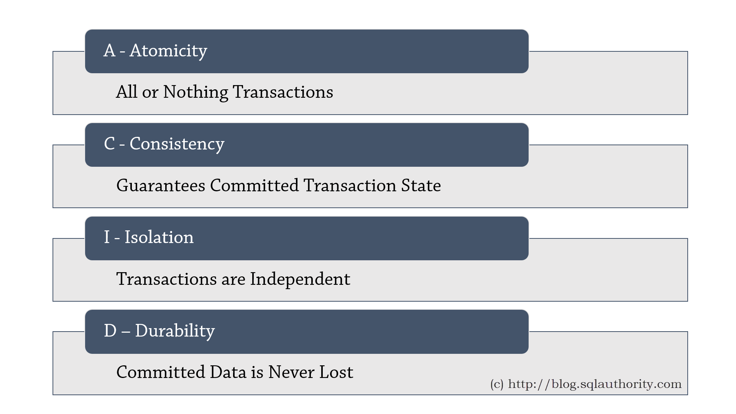
Solution is ACID transactions

Slide 8

Transaction ACID properties
E.g. transaction to transfer
AED 50 from account A to account B:
1. read_from_account(A)
2. A := A – 50
3. write_to_account(A)
4. read_from_accont(B)
5. B := B + 50
6. write_to_account(B)
1. Atomicity
if the transaction fails after step 3 and before step 6,
money will be “lost” leading to an inconsistent database state
(Failure could be due to software or hardware)
the system should ensure that updates of a partially executed transaction are not reflected in the database
1. read_from_account(A)
2. A := A – 50
3. write_to_account(A)
4. read_from_accont(B)
5. B := B + 50
6. write_to_account(B)
All
or nothing,
regarding the execution of the transaction
Notes:
Either all operations of the transaction are properly reflected in the database or none are.

Slide 9
Transaction ACID properties (Cont.)
2. Consistency
Only Valid Data will be written to the database.
If a transaction is executed that violates the database's consistency rules,
the entire transaction will be rolled back and the database will be restored to its original state.
if a transaction successfully executes, it will take the database from one consistent state to another consistent state.
Eg: the sum of A and B is unchanged by the execution of the transaction
Before transaction A=500, B=600, Total= 1100
Transaction: Transfer 50 AED from account A to account B
After transaction: A=450, B=650 , Total= 1100

Slide 10
Transaction ACID properties (Cont.)
3. Isolation
During transaction T1,
if between steps 3 and 6,
another transaction T2 is allowed to access the partially updated database,
it will see an inconsistent database
(the sum A + B will be (1050)
which is less than it should be 1100)
Solution: Isolation (Feels like only 1 transaction is executing)
Isolation can be ensured by running transactions serially (one after the other).
Perform T1 entirely then only perform T2
T1
1. read(A)[500]
2. A := A – 50[450]
3. write(A)
4. read(B) [600]
5. B := B + 50 [650]
6. write(B)
T2
read(A), read(B), print(A+B)
[450, 600, 1050]
Notes:
https://www.lifewire.com/isolation-definition-1019173

Slide 11
Transaction ACID properties (Cont.)
3. Isolation
If Joe issues a transaction against a database at the same time that Mary issues a different transaction,
both transactions should operate on the database in an isolated manner.
The database should either perform Joe’s entire transaction before executing Mary’s
or vice-versa.
This prevents Joe’s transaction from reading intermediate data produced
as a side effect of part of Mary’s transaction
that will not eventually be committed to the database.
Notes:
https://www.lifewire.com/isolation-definition-1019173

Slide 12
Transaction ACID properties
4. Durability requirement
Once a transaction has completed, its changes are made permanent in DB.
Even if the system crashes, the effects of a transaction must remain in database
Example,
if a flight booking, a seat has successfully been booked,
then the seat will remain booked even if the system crashes.

Slide 13
Example of transaction
Transfer AED 50 from account A to account B
Read(A)
A = A - 50
Write(A)
Read(B)
B = B+50
Write(B)
Atomicity - shouldn’t take money from A without giving it to B
Consistency - money isn’t lost or gained
Isolation - other queries shouldn’t see A or B change until completion
Durability - the money does not go back to A
transaction

Slide 14



Some Transaction Primitives
Examples of primitives for transactions.
Primitive | Description
BEGIN_TRANSACTION | Make the start of a transaction
END_TRANSACTION | Terminate the transaction and try to commit
ABORT_TRANSACTION | Kill the transaction and restore the old values
COMMIT | permanently saves changes to database on disk
ROLLBACK | restores the previous database state

Slide 15
Transaction Support
Transaction can have one of two outcomes:
Success:
transaction commits and database reaches a new consistent state.
Failure:
transaction aborts, and database must be restored to consistent state before it started.
Such a transaction is rolled back or undone.
Committed transaction cannot be aborted.
Aborted transaction that is rolled back can be restarted later.

Slide 16
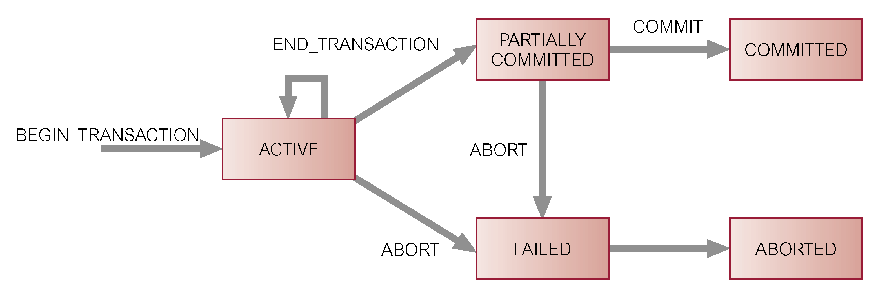
State Transition Diagram for Transaction

Slide 17
Transaction State
Active – the initial state;
the transaction stays in this state while it is executing
Partially committed – after the final statement has been executed.
Committed – after successful completion.
Failed – after the discovery that normal execution
can no longer proceed.
Aborted – after the transaction has been rolled back
and the database restored to
its state prior to the start of the transaction.

Slide 18
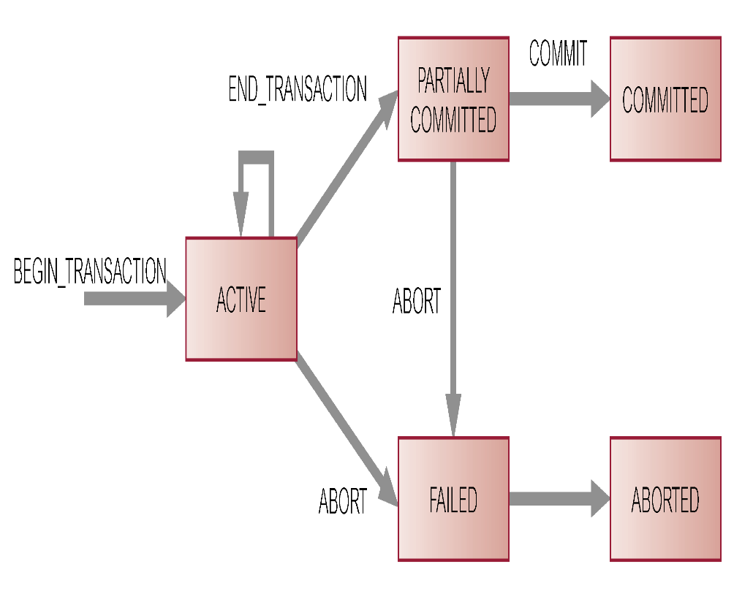
Transaction Control
a private copy of the database is created for the duration of the transaction
Transactions are started with BEGIN TRANSACTION
followed by the SQL statements
Any changes made by the SQL are made
permanent in DB by COMMIT
Part or all of a transaction can be undone using ROLLBACK

Slide 19
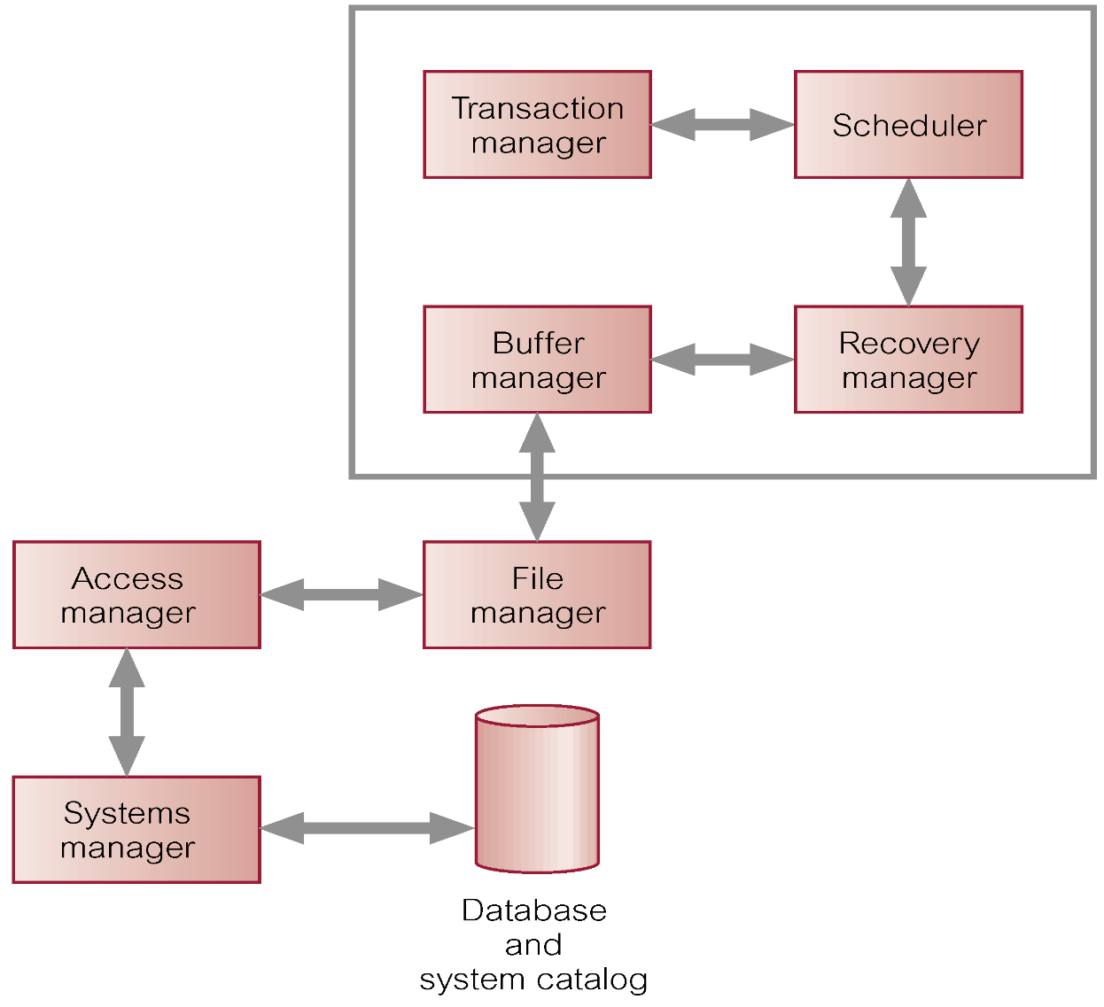
DBMS Transaction Processing System
4.2 Transaction Support
Transaction manager: coordinates transactions on behalf of application programs.
Scheduler: (or Lock manager) Maximizes concurrency and isolation to ensure integrity and consistency.
Recovery manager: ensures database restoration after failure when failure occurs during a transaction.
Buffer manager responsible for transfer of data between disk storage and main memory.

